Slide 1
Sensitivity Analysis and
Value of Information:
What Assumptions in the NEMS EMM Matter Most?
Benjamin F. Hobbs
Dept. Geography & Environmental Engineering
Whiting School of Engineering
The Johns Hopkins University
Baltimore, MD
bhobbs@jhu.edu

Slide 2
Outline
I. Framework: Value of information & sensitivity analysis
II. NEMS EMM analysis framework
  Sensitivity of performance, variables
  Sensitivity of differences between policies
III. Results

Slide 3
Value of Information about Uncertain Parameters
I. Framework
VOI: Expected improvement in decisions if reduce uncertainty
VOI considers:
  Uncertainty expressed probabilistically (“priors”)
  How decisions made (alternatives, criteria, decision rule)
  How much uncertainty can be reduced
Not same as sensitivity of outputs to parameter changes. E.g.,
  Resource planning: Costs most sensitive to fuel costs, but decisions most sensitive to demand forecasts (Energy, 1990, p. 785)
  NEMS: Power prices most sensitive to natural gas prices, but price differences between alternatives most affected by maximum capacity factor

Slide 4
Alternative VOI Indices
E(Value) under perfect information
E(Value) under improved information
E(Value) under present uncertainty
E(Value) if naïvely assume certainty (e.g., “base assumptions”)
EVPI
EVII
EV of Including
Uncertainty

Slide 5
Difficulties in
Using VOI for NEMS
What are the decisions?
Who is making them?
How will they use NEMS results?

Slide 6
Sensitivity Analysis as a Screen For VOI Assessments
1. Define objectives & variables of interest X
2. Define uncertain assumptions θ
3. Is X sensitive to θ?
4. If X sensitive, define alternatives A;
Then ask: Are differences between alternatives (X(A_{m}) - X(A_{n})) sensitive to θ?
5. If differences sensitive, define decision rule;
Then ask: does the decision among A depend upon θ?
6. If decision sensitive, then can do full-blown VOI

Slide 7
Analysis Overview
II. NEMS EMM Analysis
Sensitivity analysis of X:
  Define X
  Define θ, and alternative scenarios for each component θ_{i} (e.g., “low,” “high”)
  Evaluate which θ_{i} affect X most
For θ_{i} with most effect: Sensitivity analysis of differences among alternatives
  Base case vs Resource Portfolio Standard (7.5% by 2010)

Slide 8
Objectives, Variables X
1. Electricity Prices
  Average Prices, marginal costs, regional prices (New England, ECAR, WPCC)
2. Unplanned capacity additions and retirements
  Additions: CC, Coal, CT, Renewables, Wood & Biomass, Solid Waste, Geothermal, Coal
  Retirements: Nuclear
3. Electricity Trade (GWh)
4. Generation by type
  Gas, Petroleum, Coal, Renewable, Nuclear
5. Emissions
  NO_{x}, CO₂, SO₂

Slide 9
Categories of EMM Parameters
Capacity markets, reliability
  Demand
  Capacity reliability
Capacity economics
  Capacity costs
  Other parameters
Fuel
Demand
  DSM
  Pricing
Operations

Slide 10
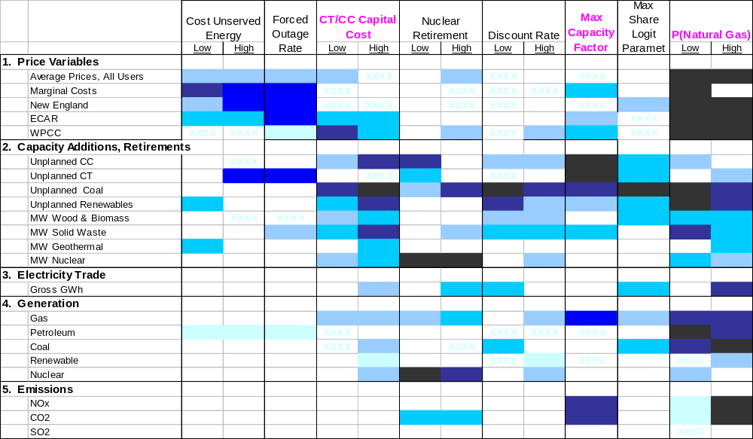
Sensitivity Results
III. Results
θ:
X

Slide 11
Comparison of Base and RPS Cases: Six θ Scenarios
Base assumptions
High capital cost of combustion turbines and combined cycles: (+$50/kW)
Low discount rate: (-100 basis points)
Decreased maximum capacity factor: (-5% from AEO2000 reference case)
Decreased market share logit parameter: (changed from 20% to 10%)
High natural gas prices: (+20% by 2020)

Slide 12
Sensitivity Analysis of X vs. Sensitivity of Differences between Alternatives (X(A_{RPS})-X(A_{base}))
Sensitivity Analysis: Assumption ranks in terms of effect upon prices (US, WPCC); coal, CC, & renewable additions; NO_{x} & CO₂:
Sensitivity of Differences: Assumption ranks in terms of effect on differences between alternatives for the same variables:
All variables:
1. P(Gas)
2. Max Cap. Factor
3. Disc. Rate
4. CC/CT Cost
5. Logit Share Para.
US price only:
1. P(Gas)
2. Disc. Rate
3. Max Cap. Factor
4. CC/CT Cost
5. Logit Share Para.
All variables:
1. CC/CT Cost
2. Disc. Rate
3. Max Cap. Factor
4. Logit Share Para.
5. P(Gas)
US price only:
1. Max Cap. Factor
2. CC/CT Cost
3. P(Gas)
4. Logit Share Para.
5. Disc. Rate

Slide 13
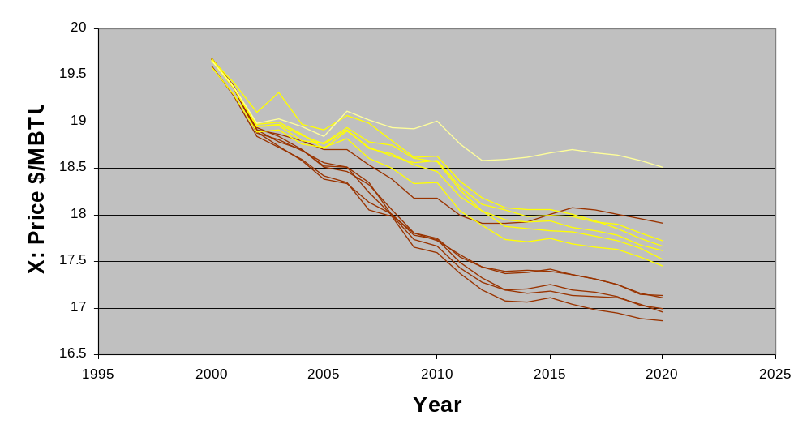
Effect of RPS and Assumptions Upon US Electricity Prices
RPS
Base Case

Slide 14
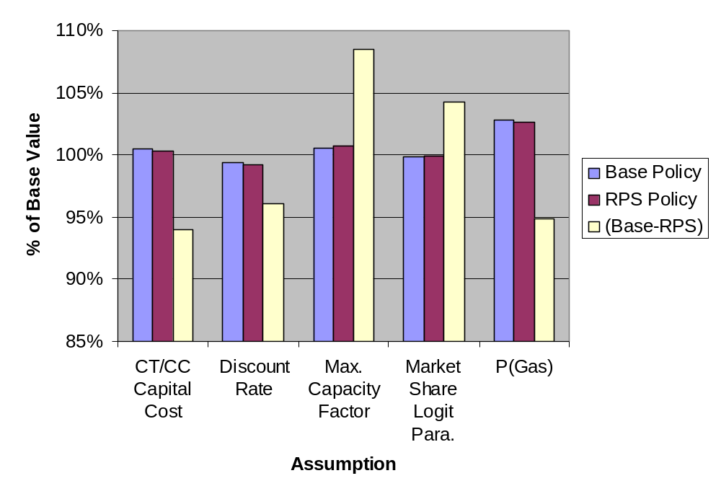
Effect Upon Average US Electricity Prices (2000-2020)
X
X(A_{RPS})-X(A_{base})

Slide 15
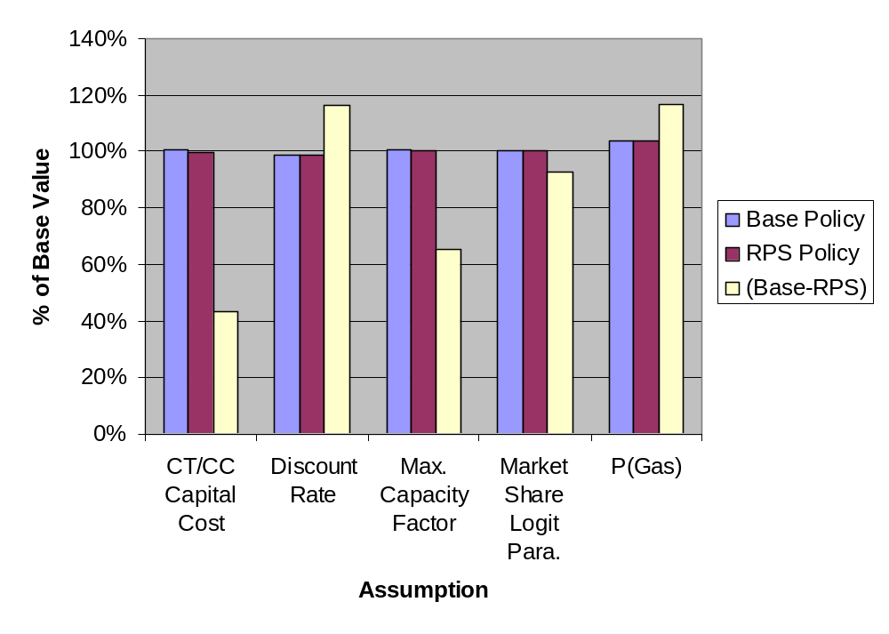
Effect Upon Average WPCC Electricity Prices (2000-2020)

Slide 16
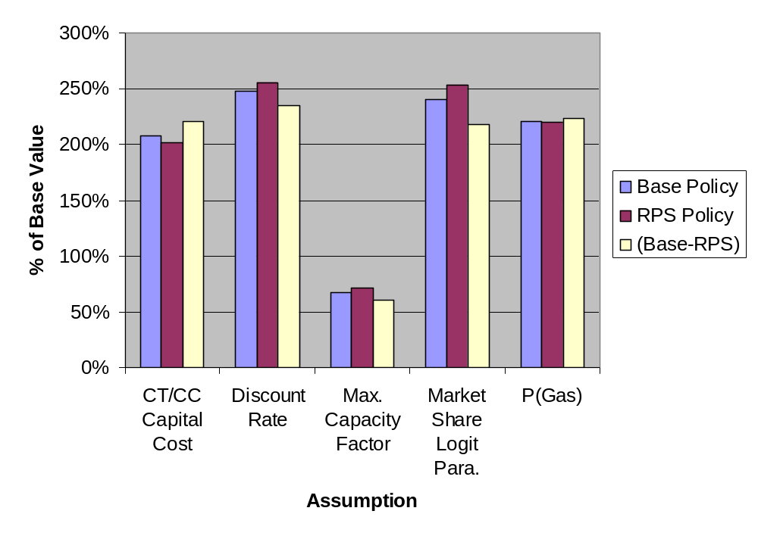
Effect Upon Unplanned Coal MW Additions (2000-2020)

Slide 17
Conclusions
Do sensitivity analysis with policy choices in mind
Sensitivity information is decision relevant
What assumptions in NEMS EMM matter most?
  Caveats:
    Only some θ
    Only two A
    Interactions among θ_{i} disregarded
    Not a VOI analysis
  Outcomes X most sensitive to natural gas prices
  Differences in prices between alternatives most sensitive to capacity cost, max capacity factor

